Slide 1
STROKE PREDICTION
GUIDED BY: PREPARED BY:
PROF. MINAL PATEL HARIKESH PRAJAPATI (18DCS093)
DARSHAN RAVAL (18DCS099)
RAJVI SHAH (18DCS109)

Slide 2
TABLE OF CONTENTS
01
03
02
04
Introduction
This module contains introduction and definition of the project.
Methodology
Describes the method used to build the project
Requirements
Specifies libraries used and requirements of the project
Conclusion
Outcomes of the project

Slide 3
INTRODUCTION
A large number of people lose their life due to stroke and it is increasing in developing countries. There are several stroke risk factors that regulate different types of stroke. Predictive algorithms help to understand the relation between these risk factors to types of strokes.
We have used several machine learning algorithms to detect the type of stroke that can occur in a patient or already occurred from their clinical report and statistical data. We have used a stroke dataset by collecting data from various sources. Then the dataset was processed to be used with the machine learning algorithms.

Slide 4
PROJECT DEFINITION
Stroke Detection is an application that can be used to improve patients’ health through early detection and treatment. We will be using different Machine Learning algorithms for prediction. Once the model is ready and gives accurate results, we will deploy the model into a web application. The application will take various parameters as input from the user such as gender, age, hypertension, heart disease, etc. and based on that prediction will be done.

Slide 5
GANTT CHART
AUGUST | SEPTEMBER | OCTOBER
Planning and Data gathering
 | Working on Building the Model
 |  | Working on Frontend and Deployment

Slide 6
REQUIREMENTS
SOFTWARE:
Anaconda/Pycharm as python interpreter.
HARDWARE:
Minimum 8GB RAM for better performance.
i5 8th Gen or above processor.

Slide 7
LIBRARIES USED
Pandas
Matplotlib
For data pre-processing
For data visualization
Scikit Learn
Flask
For building Prediction Models
For deployment of model into a web application

Slide 8
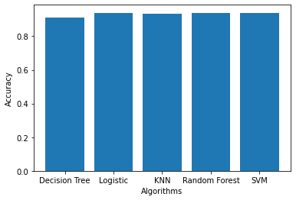
ALGORITHMS USED
We have implemented the following algorithms.
Decision Tree
Logistic Regression
kNN
Random Forest
SVM
The graph besides shows accuracy of all the 5 algorithms.
Algorithm vs Accuracy Graph

Slide 9
APPROACH
01
02
04
03
Label Encoding and
Normalisation
Data pre-processing
Importing libraries, exploratory data-analysis
Converting the labels such as gender into numeric form, changing the values of numeric columns to a common scale
Deployment
Building the Model
Working on Front-end and web deployment using Flask
Dividing the dataset into training and testing data and apply the algorithms

Slide 10
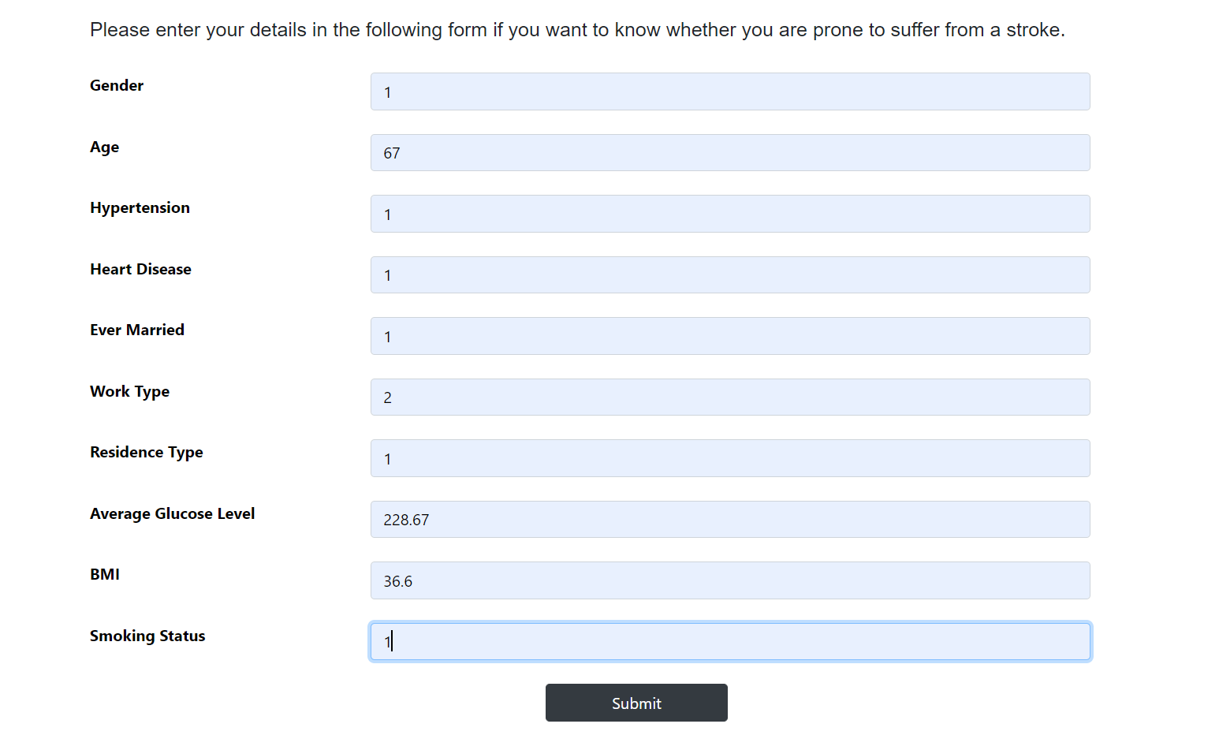
SNAPSHOTS

Slide 11
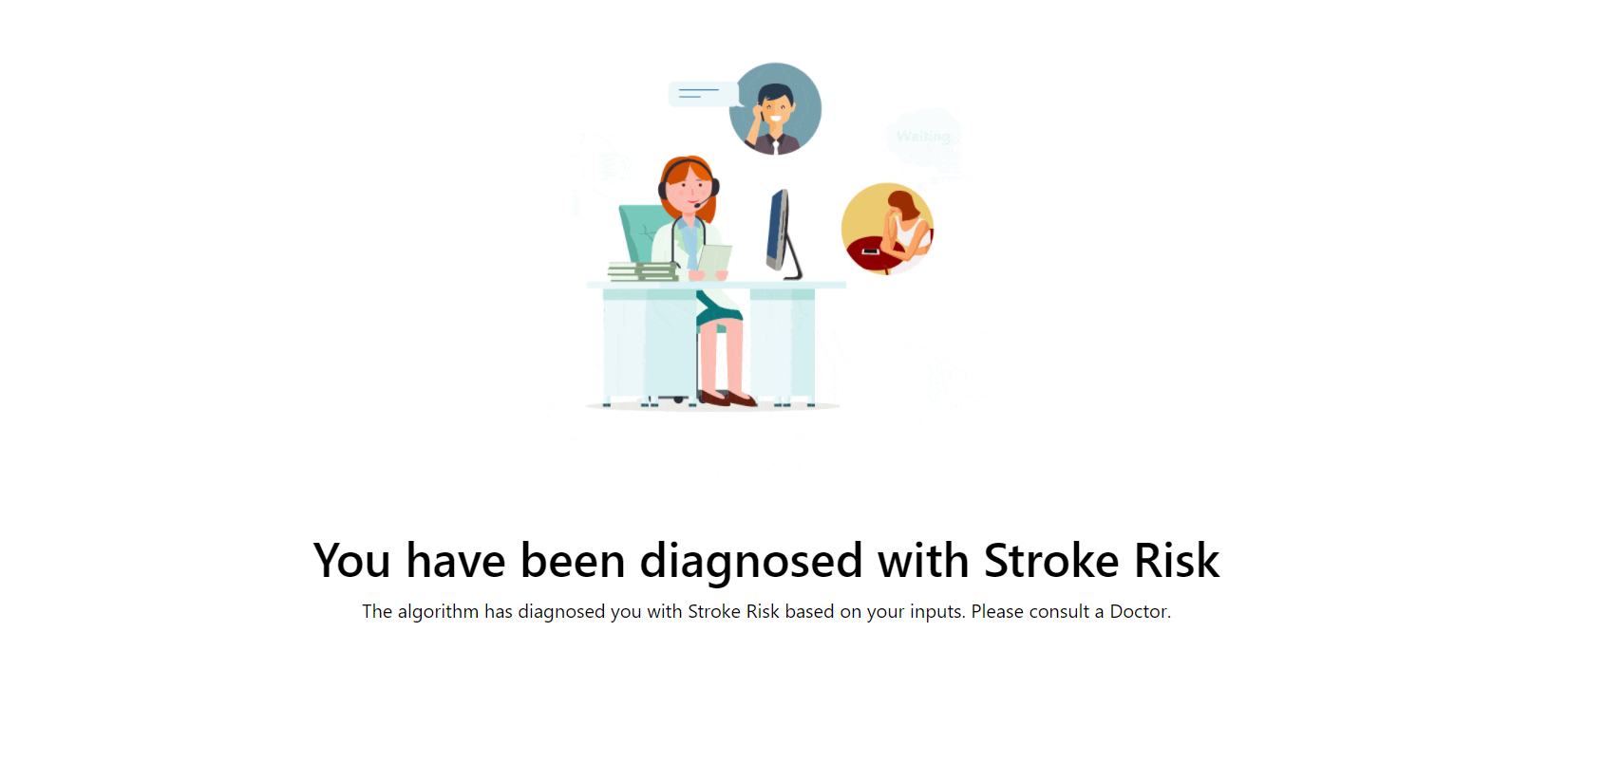
SNAPSHOTS

Slide 12
CONCLUSION
This project classifies a sufficiently large dataset of stroke-attacked patients accurately. Amongst Decision Tree, Logistic Regression, kNN Random Forest and SVM, the algorithm with a better accuracy will be used. The model can help people with a cautionary indication of being affected by stroke. Healthcare industries generate huge amounts of complex data about patients, hospitals resources, disease diagnosis, electronic patient records, medical devices, etc. Thus, this application provides an easier approach.

Slide 13
REFERENCES
https://www.researchgate.net/publication/338361726_Detection_of_Stroke_Disease_using_Machine_Learning_Algorithms
https://ieeexplore.ieee.org/document/8944689
https://www.youtube.com/watch?v=UtgrhBr3kTw
https://www.youtube.com/watch?v=hJ2sKPj5Xn4
https://www.youtube.com/watch?v=Qr4QMBUPxWo

Slide 14
THANK YOU

